Slide 1


www.cvijay.com Call: 9791558457

Slide 2

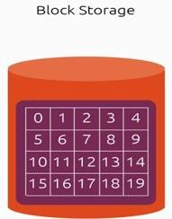
In Block storage, the data is stored in terms of blocks. Each block is assigned an arbitrary identifier by which it can be stored and retrieved, but no metadata providing further context. Database storage and Operating System is a common use for block storage.

Slide 3

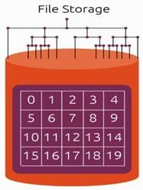
File storage provides a centralized, highly accessible location for files, and generally comes at a lower cost than block storage. File storage uses metadata and directories to organize files, which makes it a convenient option for an organization looking to simply store large amounts of data.

Slide 4

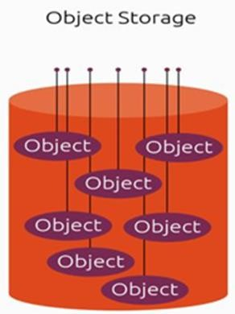
Rather than splitting files into raw data blocks, object storage clumps data together as one object that contains data and metadata. Blocks of storage do not contain metadata, so in that regard object storage can provide more context about the data, which can be helpful in classifying and customizing the files. Each object also has a unique identifier, which makes quicker work of locating and retrieving objects from storage.

Slide 5
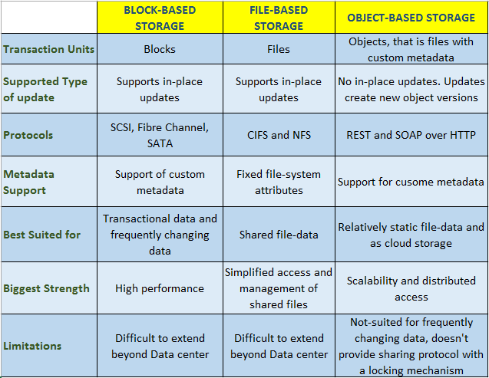

Slide 6
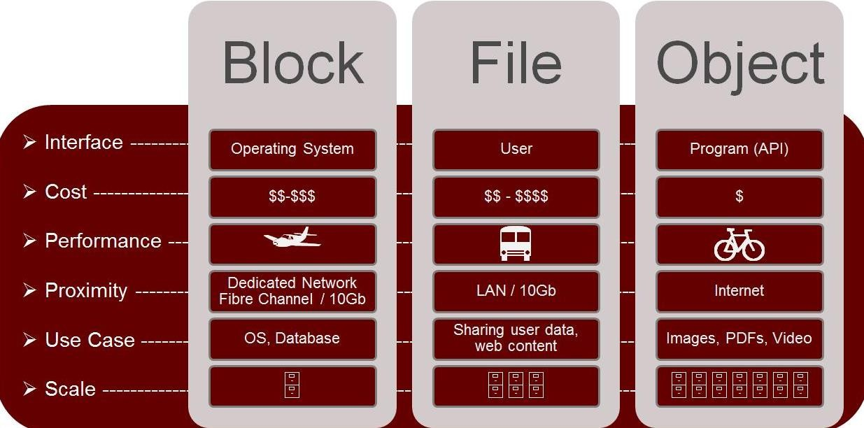

Slide 7
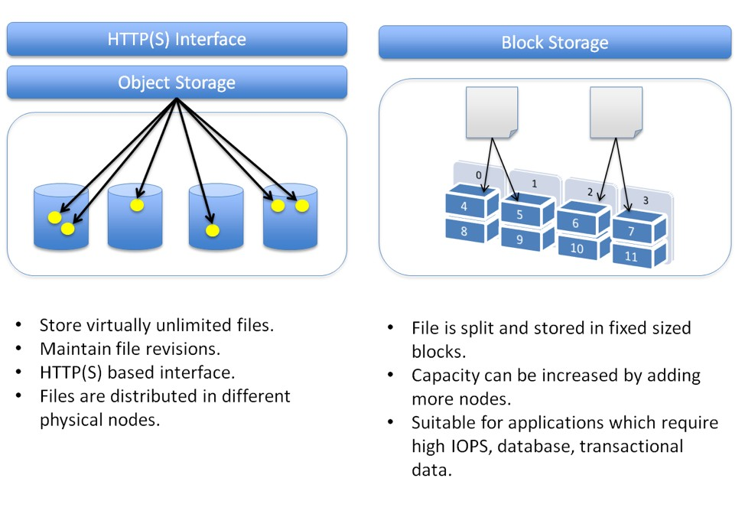

Slide 8
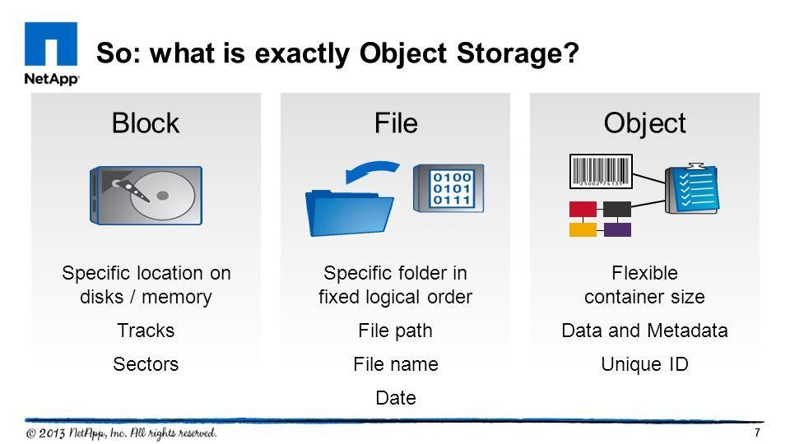

Slide 9
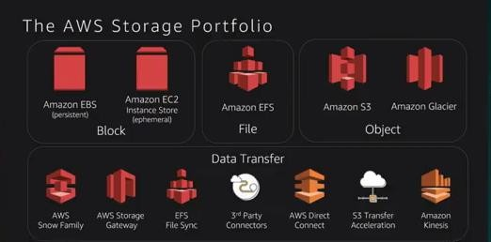

Slide 10
XYZ Enterprise has more that 1000 servers, as being PCI DSS complaint they should retain their logs for minimum 1 year. It has been observed the payment servers generate logs of 250GB every day. If that is the case then they need 250 X 365 = 89.11 rounding off 90TB. How to achieve this storage in a cost effective manner?
Traditional approach Cloud (AWS) approach
Buy required Storage devices + 20% buffer
Design for High Availability
Employ Storage Admins
Ensure Security for the device and data stored
Create account in AWS
Upload the logs to Amazon S3

Slide 11

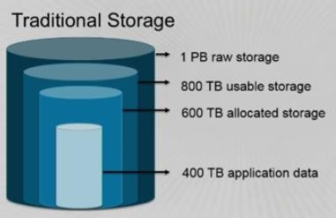

Slide 12









Slide 13






Slide 14




To support the above and many more use cases, Amazon S3 offers a range of storage classes designed :
General purpose
Infrequent access
Archive

Slide 15
USE CASE: An organization regularly backs up their application data. The application backups are required to be stored on Amazon S3 for a certain amount of time and need to be accessed instantly in the event of a disaster recovery.
Which of the following Amazon S3 storage classes would be the MOST cost-effective option to meet the needs of this scenario?
Solution: Standard – Infrequent Access (IA )

Slide 16








Slide 17










Slide 19






Slide 20





https://s3-eu-west- 1.amazonaws.com/nuageacademy/bala/index.html

Slide 21




Built for 99.99% availability for the S3 Platform | Encryption
Amazon guarantee 99.99% availability | Secure your data using ACL and Bucket Policies
Amazon guarantees 99.999999999% durability for S3 information | MFA Delete
Tiered Storage available | Pre-Signed URLs
Lifecycle Management | Multipart Upload
Versioning | Cross-Region Replication
Logging | Event Notifications

Slide 22


Cross-origin resource sharing (CORS) defines a way for client web applications that are loaded in one domain to interact with resources in a different domain. With CORS support in Amazon S3, you can build rich client-side web applications with Amazon S3 and selectively allow cross-origin access to your Amazon S3 resources.
Scenario : Suppose you are hosting a website in an Amazon S3 bucket named website as described in Hosting a Static Website on Amazon S3. Your users load the website endpoint http://website.s3-website-us-east-1.amazonaws.com. Now you want to use JavaScript on the web pages that are stored in this bucket to be able to make authenticated GET and PUT requests against the same bucket by using the Amazon S3's API endpoint for the bucket, website.s3.amazonaws.com. A browser would normally block JavaScript from allowing those requests, but with CORS, you can configure your bucket to explicitly enable cross-origin requests from website.s3-website-us-east-1.amazonaws.com.

Slide 23


All objects by default are private. Only the object owner has permission to access these objects. However, the object owner can optionally share objects with others by creating a pre-signed URL, using their own security credentials, to grant time-limited permission to download the objects.
When you create a pre-signed URL for your object, you must provide your security credentials, specify a bucket name, an object key, specify the HTTP method (GET to download the object) and expiration date and time. The pre- signed URLs are valid only for the specified duration.
Anyone who receives the pre-signed URL can then access the object. For example, if you have a video in your bucket and both the bucket and the object are private, you can share the video with others by generating a pre- signed URL.

Slide 24



































































USECASE: A large enterprise has highly sensitive customer data which is stored in several Amazon S3 buckets. Which of the features should be enabled to detect unauthorized access to the buckets?
Solution : Enable Amazon S3 server access logs

Slide 25

The Amazon S3 notification feature enables you to receive notifications when certain events happen in your bucket. To enable notifications, you must first add a notification configuration identifying the events you want Amazon S3 to publish, and the destinations where you want Amazon S3 to send the event notifications.

Slide 26
Lifecycle configuration enables you to specify the lifecycle management of objects in a bucket. The configuration is a set of one or more rules, where each rule defines an action for Amazon S3 to apply to a group of objects.
These actions can be classified as Transition actions and Expiration actions.
Example:
If you are uploading periodic logs to your bucket, your application might need these logs for a week or a month after creation, and after that you might want to delete them.
Some documents are frequently accessed for a limited period of time. After that, these documents are less frequently accessed. Over time, you might not need real- time access to these objects, but your organization or regulations might require you to archive them for a longer period and then optionally delete them later.
You might also upload some types of data to Amazon S3 primarily for archival purposes, for example digital media archives, financial and healthcare records, raw genomics sequence data, long-term database backups, and data that must be retained for regulatory compliance.

Slide 27


S3 inventory helps to manage your S3 Storage
Audit and report on the replication and encryption status of your objects
Use cases:
Business
Compliance
Regulatory needs
You can query all the data using Amazon Athena, Redshift, Presto, Hive, Spark, etc.,
You can set up multiple inventories
Data goes from a source bucket to a target bucket ( need to setup policy)

Slide 28


You can setup analytics to help determine when to transition objects from Standard to Standard IA
Does not work for ONE ZONE IA or GLACIER
Report is updated on a daily basis
First report generation takes about 24 to 48 hours

Slide 29


Amazon athena is a serverless, interactive query service that makes it easy to analyze big data in S3 using standard SQL.
Serverless service to perform analytics directly against S3 objects
Uses SQL language to query the objects
Also has JDBC / ODBC driver
Charged per query and amount of data scanned
Supports CSV, JSON, ORC, Avro and Parquet (Presto)
Use Cases: Business Intelligence / anyalytics / reporting, analyze & query VPC Flow Logs, ELB Logs, Cloud Trails, SC access Logs, etc.,

Slide 30







Slide 31



https://s3-eu-west-1.amazonaws.com/nuageacademy

Slide 32












Slide 33
Read the S3 FAQ before taking the exam.

Slide 34


Buckets and Objects are primary S3 resources
Each has its own sub-resources
Buckets Sub-resources are:
Lifecycle, website, versioning, ACL and Policies, CORS and logging (bucket access logs)
Object Sub-resources are:
ACLs and Restore (restoring an archive)
Operations on S3 are:
Bucket level operations
Object level operations

Slide 35

By default, all Amazon S3 resources are private
Only a resource owner can access the resource
The resource owner refers to the AWS account that creates the resource. For example:
The AWS account that you use to create buckets and objects own those resources
If you create an AWS Identity and Access Management (IAM) user in your AWS account, your AWS account is the Parent of the IAM user
If the IAM user uploads an object, the parent account to which the user belongs
owns the object

Slide 36

A bucket owner can grant cross-account permissions to another AWS account (or users in another account) to upload objects. In this case:
AWS account that uploads the objects, owns the objects
Bucket owner does not have permissions on the objects that other accounts own, but with below exceptions:
Bucket owner pays the bills
Bucket owner can deny access to any objects in the bucket regardless of who owns them
Bucket owner can delete any objects in the bucket regardless of who owns them
Bucket owner can archive any objects or restore archived objects regardless of who owns them

Slide 37
Managing access refers to granting permissions to others (AWS accounts and Users) to perform the resource operations by writing an access policy
You can grant s3 bucket/object permissions to:
Individual Users
AWS accounts
Make the resource public / grant permission to everyone / anonymous access
To all authenticated users (users without AWS credentials)

Slide 38

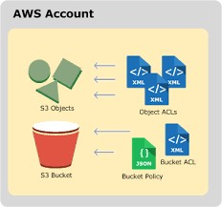
Access policy describes who has access to what
You can associate an access policy with:
A resource (bucket and object)
OR a User
Amazon S3 access policies can be categorized as follows:
Resource-based policies
User policies

Slide 39

Bucket policies and access control lists (ACLs) are resource-based
because you attach them to your Amazon S3 resources
ACL-based access policies (Bucket & Object ACLs)
Each bucket and object can have an ACL associated with it
An ACL is a list of permission identifying grantee and permission
granted
Use ACLs to grant basic read/write permissions to other AWS accounts
Bucket Policy – For a bucket, we can add a bucket policy to grant other AWS accounts or IAM users permissions for the bucket and the objects in it
Any object permissions apply only to the objects that the bucket owner creates
Bucket policies supplement, and in many cases, replace ACL-
based access policies

Slide 40
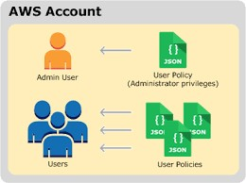
You can use AWS Identity and Access Management (IAM) to manage access to your S3 resources
Using IAM, you can create IAM users, groups and roles in your account and attach access policies to them granting them access to AWS resources including S3
You cannot grant anonymous permissions in an IAM user policy, because the policy is attached to a user
User policies can grant permissions to a bucket and the objects in it
o It can be attached to an IAM user, Group, or Role

Slide 41
User Context:
S3 checks whether the user attached policies allows the request, so basically
whether the parent account allows the operation to the IAM user or not
If the user is the root account, this validation is skipped
Bucket Context:
S3 validates whether the bucket owner ( can be the same parent account or another AWS account) has allowed the requested operation to this user
Bucket policy, Bucket ACL, Object ACL (for object operation)are all checked

Slide 42
If the parent AWS account owns the resource (bucket or object), it can grant resource permissions to its IAM user by either the user policy or the resource policy
If the bucket and object owner is the same.
Access to the object can be granted in the bucket policy, which is
evaluated at the bucket context
If the Owners are different,
The object owners must use an object ACL to grant permissions
If the AWS account that owns the object is also the parent account to which the IAM user belongs, it can configure object permissions in a user policy, which is evaluated at the user context

Slide 43
S3 ACLs enables you to manage access to buckets and objects
Each bucket and object has an ACL attached to it
It defines which AWS accounts (grantees) or predefined S3 groups are granted access and the type of access
You can’t provide permissions to individual IAM users here
Grantee Accounts (Cross Account Access) can then delegate the access provided by other accounts to their individual users
When you create a bucket or object, S3 creates a default ACL that grants the resource owner full control over the resource

Slide 44
Can be used only grant permissions to AWS accounts and pre-defined groups.
Can’t grant permissions to individual user’s.
Can only grant basic read/write permissions.
Can’t grant conditional access.
Can’t grant deny permissions.

Slide 45


Amazon S3 has a set of following predefined groups :
Authenticated Users Group –
This group represents all AWS accounts. Access permission to this group allows any AWS account to access the resource. However, all requests must be signed (authenticated)
When you grant access to the Authenticated Users Group any AWS authenticated user in the world can access your resource
All Users Group –
Access permission to this group allows anyone in the world can access the resource
Requests can be either signed (authenticated) or unsigned (anonymous)
AWS highly recommends that you never grant ALL Users Group with WRITE, WRITE_ACP or FULL CONTROL permissions
Log Deliver Group –
WRITE permission on a bucket enables this group to write server access logs

Slide 46
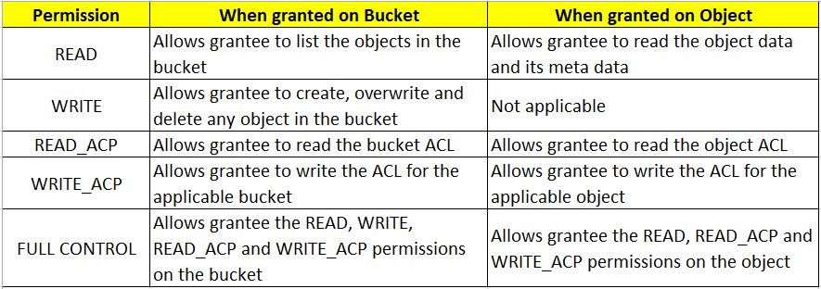
Following table lists the set of ACL permissions that S3 supports for bucket and object

Slide 47
An Object ACL is the only way to manage access to objects not owned by the
bucket owner
This can happen when the bucket owner authorizes another account to upload objects to the bucket, but still the bucket owner will not own the objects
However, the bucket owner can deny access to the object through bucket policy, even if the object ACL allows it
The bucket owner can delete any object regardless of whether he owns the object or not
When managing granular permissions at the object level is required
Bucket policies are limited to 20KB in size
Object ACLs are limited to 100 granted permissions per ACL

Slide 48
Only AWS recommended use case for the bucket ACL is to grant write permission to the Amazon S3 Log Delivery Group to write access log objects to your bucket
If you want S3 to deliver access logs to your bucket, you will need to grant write permission on the bucket to the Log Delivery Group
You can use bucket and object ACLs to grant cross-account permissions to other accounts, but ACLs support only a finite set of permission, these don’t include all S3 permissions

Slide 49

You can use ACLs to grant basic read/write permissions to other AWS accounts
There are limitation in managing permissions using ACLs
For Ex: You can grant permission only to other AWS accounts, you cannot grant permissions to users in your account
You cannot grant conditional permissions, nor can you explicitly deny permissions. ACLs are suitable for specific scenarios
For Ex: If a bucket owner allows other AWS account to upload objects, permissions to these objects can only be managed using Object ACL by the AWS account that owns the object

Slide 50
If an AWS account that owns a bucket wants to grant permission to users in its account, it can use either a bucket policy or a user policy
If the AWS account that owns the bucket also owns the object, then it can write a bucket policy to manage the object permission
If you want to manage cross-account permissions for all Amazon S3 permissions then use bucket policy

Slide 51
User policies support granting permission for all Amazon S3 operations
The user policies are for managing permissions for users in your account
If the AWS account that owns the object wants to grant permission to a user in its account, it can use a user policy
An IAM User must have permissions from the parent account to which it belongs, and from the AWS account that owns the resource the user wants to access. The permission can be granted as follows:
Permission from the parent account – The parent account can grant permissions to its user by attaching a User Policy
Permission from the resource owner – The resource owner can grant permission to either the IAM User ( using a bucket policy) or the parent account (using a bucket policy, bucket ACL, or object ACL)

Slide 52

If an AWS account owns a resource, it can grant permissions to other AWS
account
Then the other AWS account can then delegate those permissions, or a subset of them to users in the account
An account that receives permissions from another account cannot delegate permission to the third account

Slide 53






Slide 54






Slide 55
USE CASE: A company uses Amazon S3 for storing variety of files. A Solution Architect needs to design a feature that will allow users to instantly restore any deleted files within 30 days of deletion.
Which is the MOST cost efficient solution?
Solution: Enable versioning and create a lifecycle policy to remove expired versions after 30 days

Slide 56

It is used to upload an Object in parts
Parts are upload independently and in parallel, in any order and will get assembled at the target location
It is recommended for objects size of 100 MB or larger
However, you can use for object sizes starting from 5MB to 5TB
You must use it for objects larger than 5GB
This is done thru S3 Multipart upload API

Slide 57


Multi Factor Authentication (MFA) Delete is a versioning capability that adds another level of security in case your account is compromised
This adds another layer of security for the following:
Changing your bucket’s versioning state
Permanently deleting an object version
MFA Delete requires:
Your security credentials
Code displayed on an approved physical or Software based authentication device
This provides maximum protection to your objects

Slide 58
USE CASE: A company provides Amazon S3 access to a small group of users from the Accounting department for a single S3 bucket. A Solutions Architect wants to ensure that users are able to recover data if it was deleted.
Which of the following solutions will help ensure that data can be easily restored by the Accounting team?
Solution: Enable versioning for the S3 bucket

Slide 59





Slide 60

By default, all newly created buckets are private
We can set up Access Control to the bucket using:
Bucket Policy
Access Control Lists
S3 buckets can be configured to create access logs, which log all requests made to the S3 bucket.
Encryption:
In Transit
SSL
At Rest
Server Side Encryption
S3 Managed Keys – SSE-S3 (AES 256)
AWS Key Management Service, Managed Keys – SSE-KMS
Client Side Encryption
Server Side Encryption with customer provided keys – SSE-C

Slide 61
USE CASE: A company has asked a Solutions Architect to ensure that data is protected during data transfer to and from Amazon S3.
Use of which service will protect the data in transit?
Solution: HTTPS

Slide 62
USE CASE: A company is using Amazon S3 as its local repository for weekly analysis reports. One of the company wide requirements is to secure data at rest using encryption. The company chose Amazon S3 server-side encryption. The company wants to know how the object is decrypted when a GET request is issued.
Which of the following answers this question?
The user needs to place a PUT request to decrypt the object
The user needs to decrypt the object using a private key
Amazon S3 manages encryption and decryption automatically
Amazon S3 provides a server-side key for decrypting the object

Slide 63


Glacier is an extremely low cost storage service for data archival. Amazon Glacier stores data for as little as $0.01 per GB per month, and is optimized for data that is infrequently accessed and for which data retrieval times of 3 – 5 hours are suitable.

Slide 64




Slide 65




Slide 66











Slide 67
Expedited (1 to 5 minutes retrieval) - $0.03 per GB and $0.01 per request
Standard ( 3 to 5 Hours) - $0.01 per GB and $0.05 per 1000 requests
Bulk ( 5 to 12 Hours) - $0.0025 per GB and $0.025 per 1000 requests

Slide 68
USE CASE: An organization stores customer files and must frequently increase the size of its on-premises storage system to enable quick access and archiving. The organization needs an AWS solution.
How can this requirement be met at the lowest cost?
Solution: Use Amazon S3 for regular storage and Amazon Glacier for archiving data

Slide 69
USE CASE: A Solutions Architect works for an insurance company that has a large number of patient health records. Each record will be used once when assessing a patient and will need to be securely stored for seven years to meet regulations. In rare cases the Solutions Architect may need to retrieve a patient record in five hours.
Which type of AWS storage would deliver the most cost- effective solution?
Solution: Amazon Glacier

Slide 70





































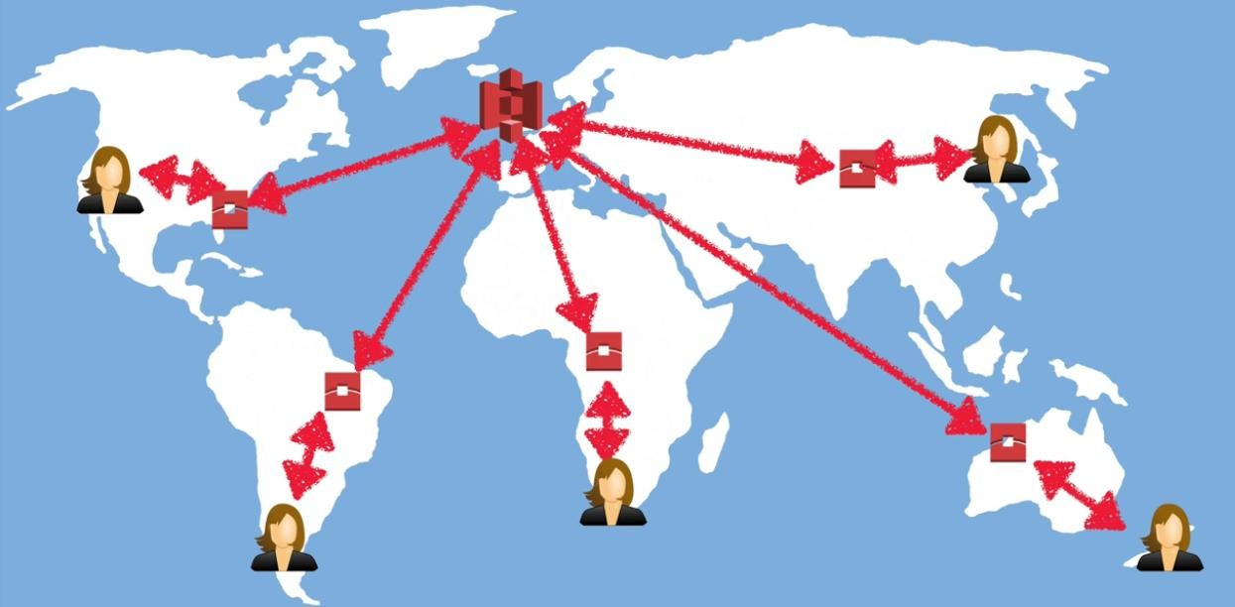

Slide 71
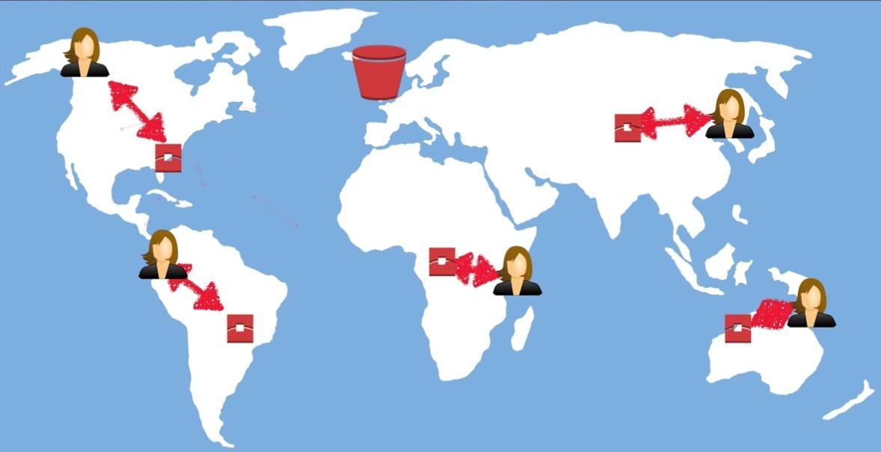
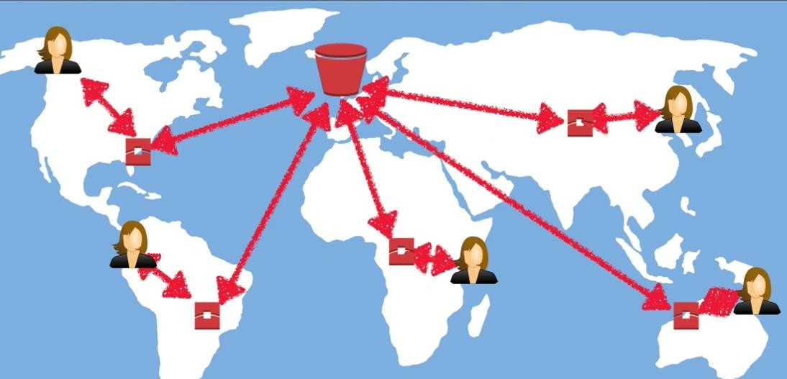

Slide 72

AWS Import/Export disk accelerates moving large amount of data in and out of the AWS cloud using portable storage devices for transport. AWS Import/Export disk transfers your data directly onto and off of storage devices using Amazon’s high-speed internal network and bypassing the internet

Slide 73

Snowball
Snowball Edge
SnowMobile
Snowball available in all regions. Snowball uses multiple layers of security designed to protect your data including tamper-resistant enclosures, 256-bit encryption, and an industry standard Trusted Platform Module (TPM) designed to ensure both security and full chain of custody of the data. Once the data transfer job has been processed and verified, AWS performs software erasure of the Snowball appliance

Slide 74

Snowball Edge adds computational capability to the device
100TB capacity with either:
Storage Optimized – 24 vCPU
Compute Optimized – 52 vCPU and Optional GPU
Supports a custom EC2 AMI so you can perform processing on the go
Supports custom Lambda functions
Very useful to pre-process the data while moving
Use Case: Data Migration, Image collation, IoT capture, machine learning

Slide 75
Storage Gateway
Storage Gateway is using to make a connection between on-premise and AWS cloud

Slide 76












































































storage in the AWS
Cloud
files
volumes
virtual tapes

Slide 77
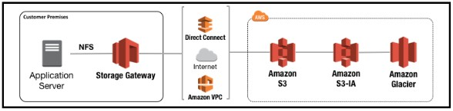
File Gateway– File gateway is a type of AWS Storage Gateway that supports a file interface into
Amazon S3. File gateway combines a service and virtual software appliance, enabling you to store
and retrieve objects in Amazon S3 using industry-standard file protocols such as Network File System (NFS). The software appliance, or gateway, is deployed into your on-premises environment as a virtual machine (VM) running on Vmware ESXi. The gateway provides access to objects in S3 as files on a NFS mount point.
With file gateway, you can do the following:
You can now store and retrieve files directly using NFS 3 or 4.1 protocol.
You can access your data directly in S3 from any cloud application or service.
You can manage your data directly in Amazon S3 using lifecycle policies, cross-region replication,
and versioning.

Slide 78
Volume Gateways
Volume gateway is a blocked storage and can be mounted as iSCSI from On-premises servers. This can be used to run Operating system or host databases.
This can be used to run operating system.
Can be used as virtual storage to run database server.
Stored in cloud as EBS snapshot.
Two Types:
Cached Volumes stores frequent accessed data locally and the rest data stored in S3. provide low latency for frequently accessed data. Volume size’s from 1 GB to 32 TB.
Stored Volumes stores full dataset locally and backup asynchronously to AWS S3 in the form of EBS snapshot. Provides low latency for full database. Volume sizes will be stored from 1 GB to 16 TB.

Slide 79

Cached Volumes Architecture -
Cached volumes let you use Amazon Simple Storage Service (Amazon S3) as your primary data storage while retaining frequently accessed data locally in your storage gateway. Cached volumes minimize the need to scale your on-premises storage infrastructure, while still providing your applications with low latency access to their frequently accessed data. You can create storage volumes up to 32 TiB in size and attach to them as iSCSI devices from your on- premises application servers. Your gateway stores data that you write to these volumes in Amazon S3 and retains recently read data in your on-premises storage gateway's cache and upload buffer storage.
Cached volumes can range from 1 GiB to 32 TiB in size. Each gateway configured for cached volumes can support up to 32 volumes for a total maximum storage volume of 1,024 TiB(1 PiB).
In the cached volumes solution, AWS Storage Gateway stores all your on-premises application data in a storage volume in Amazon S3.

Slide 80
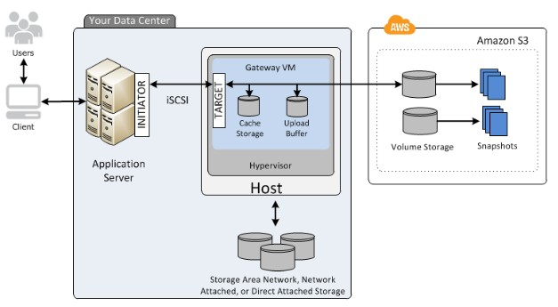
The following diagram provides an overview of the cached volumes deployment
After you've installed the AWS Storage Gateway software appliance—the virtual machine (VM)—on a host in your data center and activated it, you can use the AWS Management Console to provision storage volumes backed by Amazon S3.
You also allocate disks on-premises for the VM. These on-premises disks serve the following purposes:
Disks for use by the gateway as cache storage
Disks for use by the gateway as the upload buffer

Slide 81
Stored Volumes Architecture
Stored volumes let you store your primary data locally, while asynchronously backing up that data to AWS. Stored volumes provide your on-premises applications with low-latency access to their entire datasets, while providing durable, off-site backups. You can create storage volumes and mount them as iSCSI devices from your on-premises application servers. Data written to your stored volumes is
stored on your on-premises storage hardware. This data is asynchronously backed up to Amazon Simple
Storage Service (Amazon S3) in the form of Amazon Elastic Block Store (Amazon EBS) snapshots.
Stored volumes can range from 1 GiB to 16 TiB in size and must be rounded to the nearest GiB. Each gateway configured for stored volumes can support up to 32 volumes and a total volume storage of 512 TiB (0.5 PiB).
With stored volumes, you maintain your volume storage on-premises in your data center. That is, you store all your application data on your on-premises storage hardware. Then, using features that help maintain data security, the gateway uploads data to the AWS Cloud for cost-effective backup and rapid disaster recovery. This solution is ideal if you want to keep data locally on-premises, because you need to have low-latency access to all your data, and also to maintain backups in AWS.

Slide 82
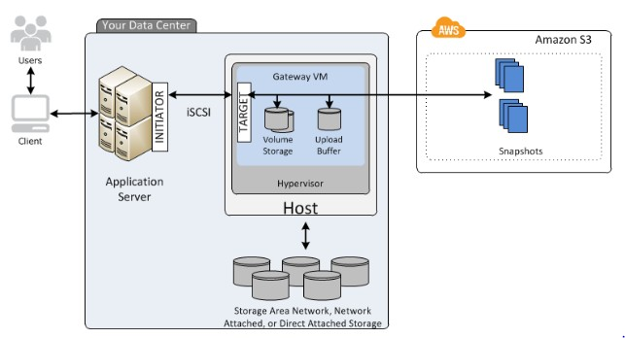
The following diagram provides an overview of the stored volumes deployment

Slide 83
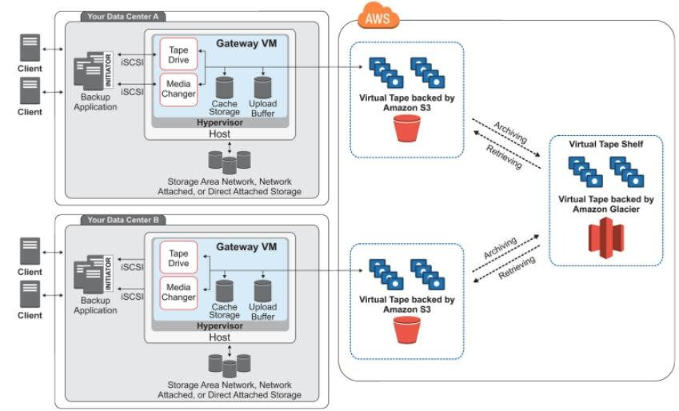
Tape Gateway
Tape Gateway offers a durable, cost-effective solution to archive your data in the AWS Cloud. The VTL interface it provides lets you leverage your existing tape-based backup application infrastructure to store data on virtual tape cartridges that you create on your tape gateway. Each tape gateway is preconfigured with a media changer and tape drives, which are available to your existing client backup applications as iSCSI devices. You add tape cartridges as you need to archive your data.
The following diagram provides an overview of the tape gateway deployment.

Slide 84

File Gateway – For flat files, stored directly on S3.
Volume Gateway
Stored Volumes – Entire Dataset is stored on site and is asynchronously backed up to S3.
Cached Volumes – Entire Dataset is stored on S3 and the most frequently accessed data is cached on site.
Gateway Virtual Tape Library (VTL)
Used for backup and uses popular backup applications like NetBackup, Backup Exec, Veam etc.,

